Slide 1



Immune system basics
Tumor cell
T cell
How tumors ‘hide’
Immune checkpoints
Immune checkpoint inhibitors (ICIs)
Immune Checkpoint Inhibitors
When do we use ICIs?
Side effects of ICIs
CASES
Notes:
Key take Home Points

Slide 2
Immune system basics
Tumor cell
MHC
TCR
T cell
How tumors ‘hide’
Immune checkpoints
Mutated peptide
(‘non-self’)
Immune checkpoint inhibitors (ICIs)
When do we use ICIs?
Side effects of ICIs
CASES
Notes:
Suggested prompt: Does anyone remember how your adaptive immune system recognizes infected cells or cancer cells?
Cancer cells differ from regular cells in that they have undergone mutations in various proteins to allow them to grow in an unregulated manner. On the surface of all cells is a molecule called major histocompatibility complex or MHC for short. This MHC molecule displays pieces of the proteins that cells express to show the immune system whether it is a healthy cell, an infected cell, or a cancerous cell. T cells, part of the adaptive immune system, can recognize cancerous cells that are expressing pieces of these mutated proteins on the MHC molecule which binds to the T cell receptor (TCR). When T cells ‘see’ a cancerous cell through this TCR-MHC interaction, they kill the cancer cell by secreting toxic granules. The immune system is constantly surveying our bodies for cancerous cells and in most cases, successfully destroys these cells before they develop into tumors. When cancer cells figure out a way to ‘hide’ from these T cells, then tumors can develop

Slide 3
Immune system basics
Tumor cell
MHC
TCR
T cell
How tumors ‘hide’
Immune checkpoints
Mutated peptide
(‘non-self’)
Immune checkpoint inhibitors (ICIs)
PD-L1 and PD-1 interact and induces T cell ‘exhaustion’
When do we use ICIs?
PD-L1
Tumor cell
PD-1
Side effects of ICIs
T cell
CASES
CTLA-4
CTLA-4 interacts with several ligands and induces T cell ‘exhaustion’
Notes:
Tumor cells can ‘hide’ from the adaptive immune system through various mechanisms. One of these mechanisms it by expressing a molecule called programmed death ligand 1 (PD-L1) which can bind to programed death 1 (PD-1) on T cells. This interaction ‘puts the breaks’ on the T cells and effectively prevents this T cell from killing the tumor cell. Similarly, tumor cells can express various ligands that bind to cytotoxic T-lymphocyte-associated protein 4 (CTLA-4) on T cells which again ‘puts the breaks’ on the T cell and prevents it from killing the cancer cell.

Slide 4
Immune system basics
Tumor cell
MHC
TCR
T cell
How tumors ‘hide’
Immune checkpoints
Mutated peptide
(‘non-self’)
Immune checkpoint inhibitors (ICIs)
When do we use ICIs?
PD-L1
Normal cells
PD-1
Side effects of ICIs
T cell
CASES
CTLA-4
Immune checkpoints are mechanisms by which our immune system prevent autoimmunity
Notes:
This mechanism of ‘putting the breaks’ on the adaptive immune response is a mechanism that tumors have hijacked from our regular cells. Our normal tissue, expresses these molecules (PD-L1 and ligands for CTLA-4) which are collectively called immune checkpoints. Immune checkpoints help prevent the adaptive immune system from destroying your normal tissue which would lead to autoimmune diseases

Slide 5
Immune system basics
Tumor cell
MHC
TCR
T cell
How tumors ‘hide’
Immune checkpoints
Mutated peptide
(‘non-self’)
Immune checkpoint inhibitors (ICIs)
Anti-PD-L1
(avelumab, atezolizumab, durvalumab)
When do we use ICIs?
Anti-PD-1
(nivolumab, pembrolizumab, cemiplimab)
PD-L1
Side effects of ICIs
Tumor cell
PD-1
T cell
CASES
CTLA-4
Anti-CTLA-4
(ipilimumab)
Notes:
Suggested prompt: What do you think would happen then if we blocked these immune checkpoints?
In order to ‘take off the breaks’ and allow T cells to recognize cancer cells, numerous immune checkpoint inhibitors (ICIs) have been developed. These drugs are monoclonal antibodies that can bind to these immune checkpoint proteins, thereby allowing the T cells to remain active and kill cancer cells. The drugs listed on the slide represent the current FDA approved agents as of November 2021. Many more are in development and are likely to be approved in the coming years.

Slide 6
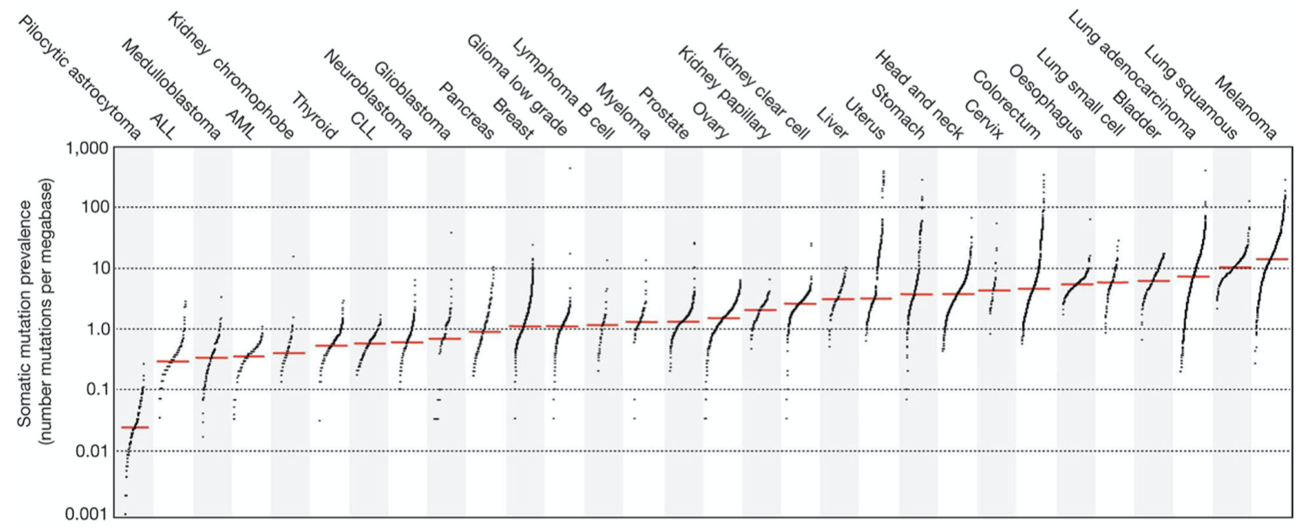
H
Immune system basics
Low number of mutations
High number of mutations
Tumor cell
MHC
TCR
T cell
How tumors ‘hide’
Lung cancer
Bladder
Melanoma
Immune checkpoints
Mutated peptide
(‘non-self’)
Immune checkpoint inhibitors (ICIs)
Number of mutations
Tumors with more mutations have more ‘mutated peptides’ that allow the immune system to ‘see’ the tumor cells
When do we use ICIs?
Which cancers have a lot of mutations? ²
Side effects of ICIs
Tumors that developed from recurrent exposure to mutagens such as melanoma (UV light), lung cancer (smoking)
CASES
Which cancers have immunotherapy FDA approval?
Head & neck cancer, melanoma, Merkel cell carcinoma, hepatocellular carcinoma, renal cell carcinoma, endometrial carcinoma, cervical cancer, lung cancer (small cell and non-small cell), malignant pleural mesothelioma, triple negative breast cancer, gastric & GEJ cancer, classical Hodgkin’s lymphoma, urothelial carcinoma (BCG-unresponsive).
Notes:
Suggested prompt: Has any one seen a patient on an immune checkpoint inhibitor? If so what cancer(s) were they treating?
In order to understand when these agents are helpful, we need to go back to the concept that our immune system recognizes tumor cells and ‘bad cells’ because of the mutated proteins they express. This is the major way that our immune system can distinguish normal cells from cancerous cells. As a result, cancers that have more mutations are more susceptible to immune destruction because there are more targets for the immune system to see. The dot plot shown at the top of the slide, stratifies cancer types across the X axis based on the number of somatic mutations identified using next generation sequencing along the Y axis. Cancers that arise from exposure to classic mutagens such as UV light causing melanoma and tobacco causing lung and bladder cancer have higher numbers of mutations and are more ‘immunogenic’ or recognizable to the immune system. Therefore, the cancers listed to the right of this graphic are more likely to respond to immune checkpoint inhibitors. At the bottom of the slide are listed all of the cancer types that ICIs are FDA approved to treat.
Could tie this concept back into whatever cancer type(s) the audience member stated that they saw being treated with one of these agents

Slide 7
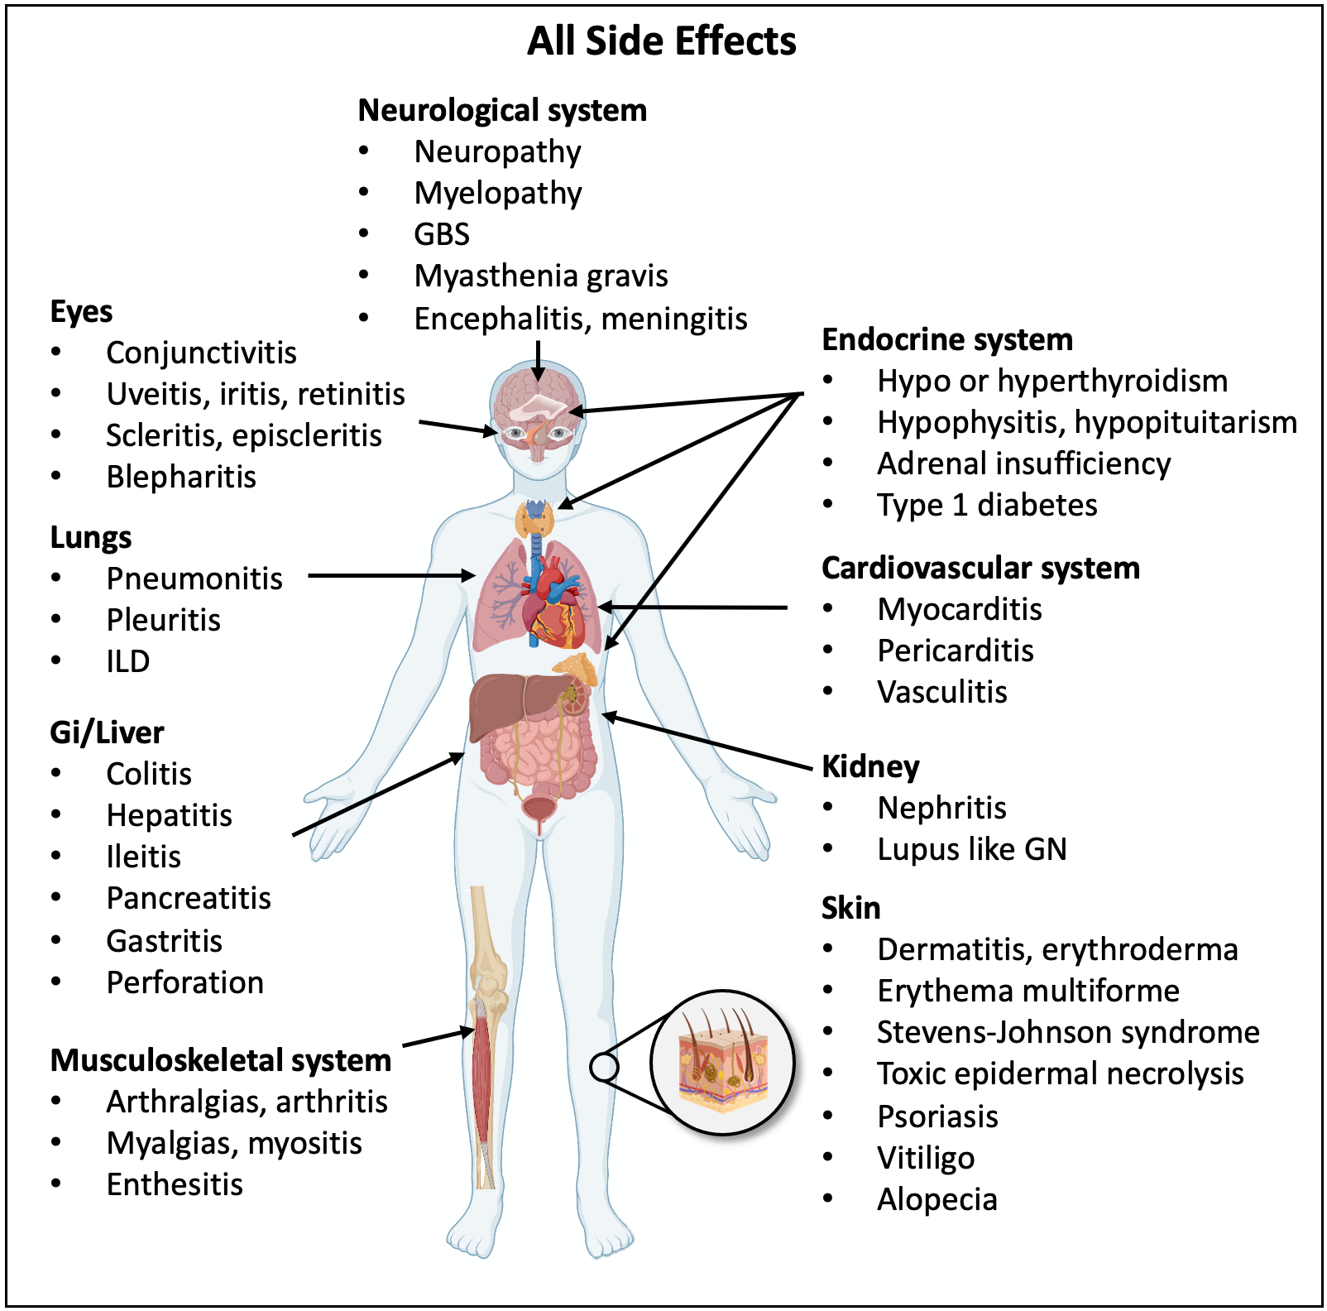
All Side Effects
Most common
Irreversible
Most Deadly
Immune system basics
How tumors ‘hide’
Immune checkpoints
Immune checkpoint inhibitors (ICIs)
When do we use ICIs?
Side effects of ICIs
CASES
Reference: 3-5; Created with BioRender.com
Notes:
Severe irAEs are as high as 16% in anti-PD-1 and up to 27% in anti-CTLA-4 antibody treatment. Moreover, in combination, irAEs rise to as much as 55% of the patients
Most commonly develop 8–12 weeks of commencing treatment, though can occur any time

Slide 8
All Side Effects
Most common
Irreversible
Most Deadly
Immune system basics
How tumors ‘hide’
Immune checkpoints
Immune checkpoint inhibitors (ICIs)
When do we use ICIs?
Side effects of ICIs
CASES
Reference: 3-5; Created with BioRender.com
Notes:
Severe irAEs are as high as 16% in anti-PD-1 and up to 27% in anti-CTLA-4 antibody treatment. Moreover, in combination, irAEs rise to as much as 55% of the patients
Most commonly develop 8–12 weeks of commencing treatment, though can occur any time

Slide 9
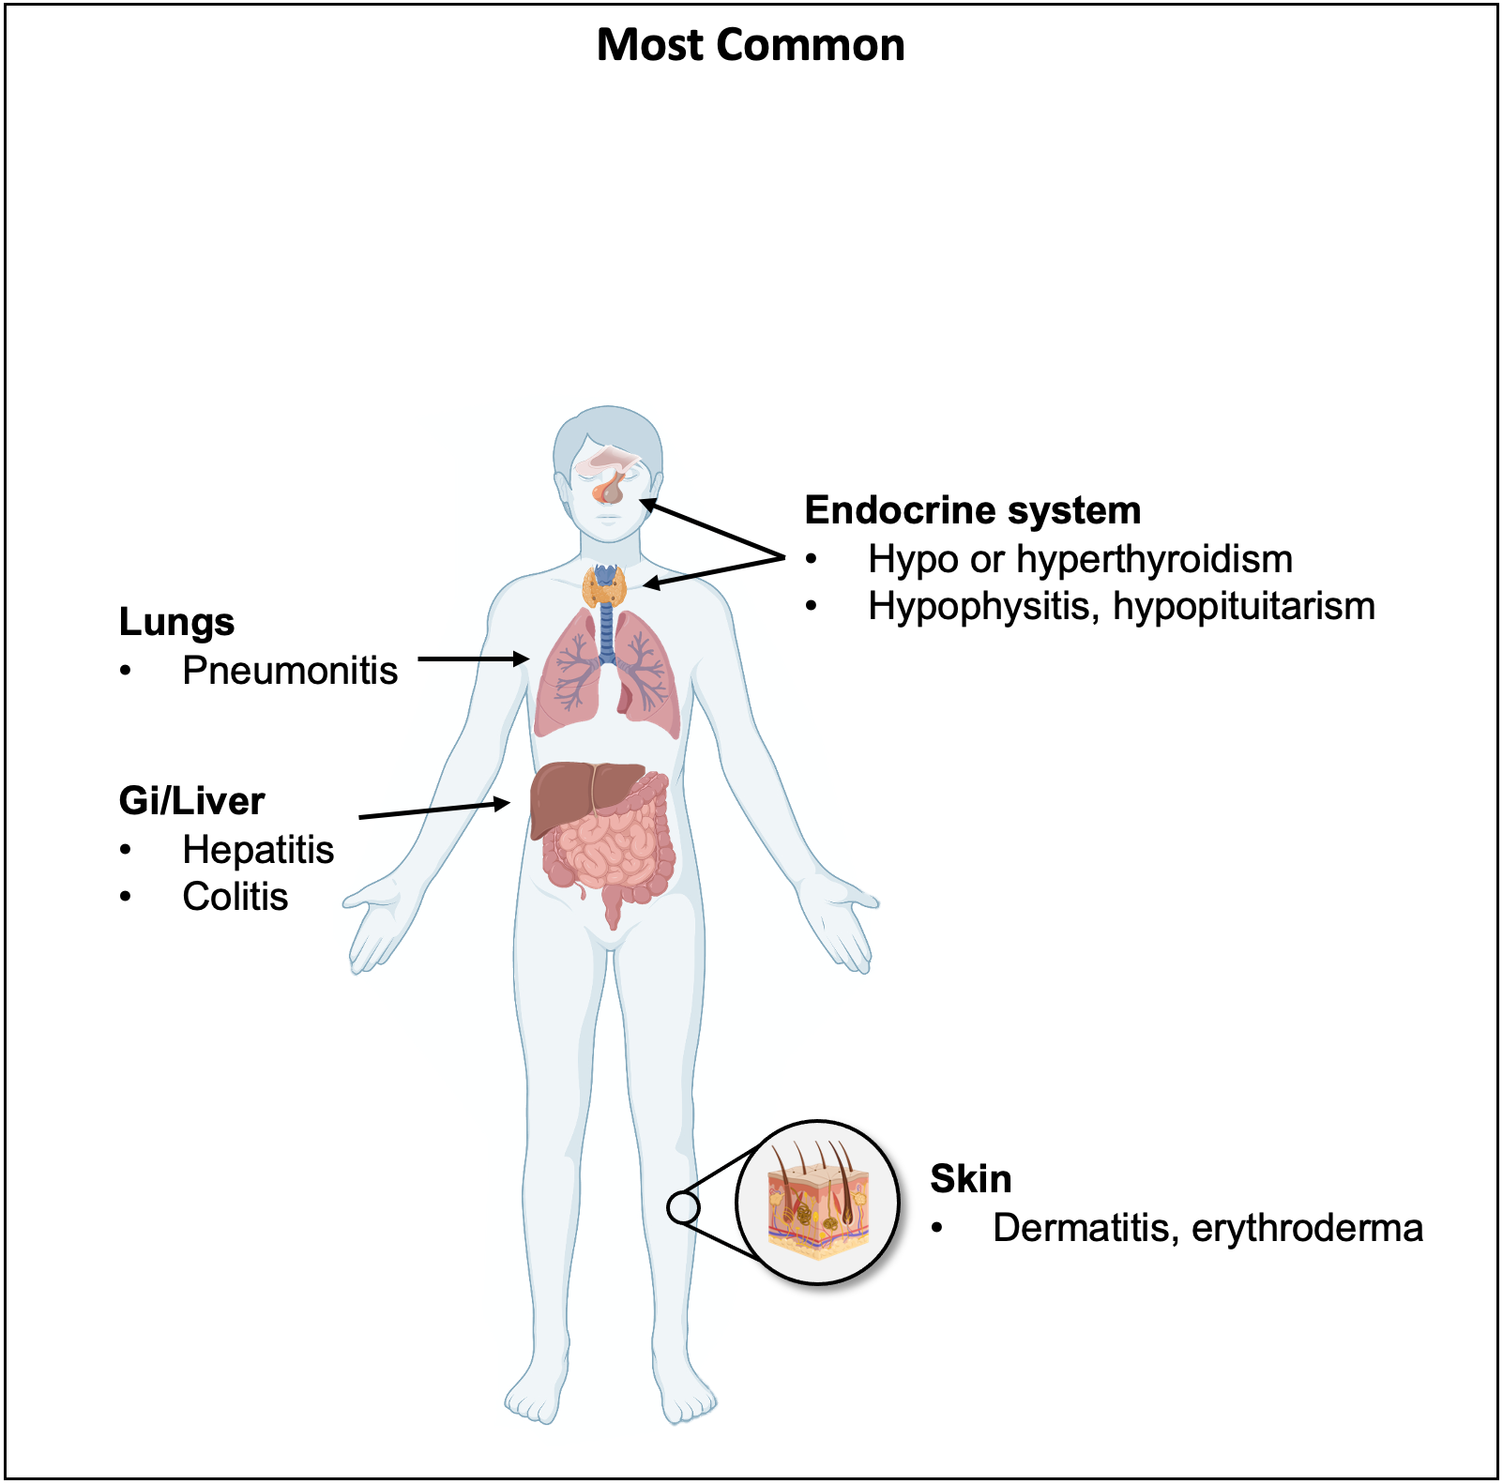
All Side Effects
Most common
Irreversible
Most Deadly
Immune system basics
How tumors ‘hide’
Immune checkpoints
Immune checkpoint inhibitors (ICIs)
When do we use ICIs?
Side effects of ICIs
CASES
Reference: 3-5; Created with BioRender.com
Notes:
Suggested prompt: Based on how these agents work, what types of side effects would you expect these drugs to cause? Has anyone seen a patient(s) who had a side effect from an immune checkpoint inhibitor?
Intuitively, since immune checkpoint inhibitors ‘take the breaks’ off of T cells in a non-specific manner, these drugs can cause autoimmune disease. Essentially any organ can be targeted as seen on the ‘All side effects’ slide. The most commonly effected organs are GI/liver, lungs, skin, thyroid and pituitary. The frequency and severity of these side effects depends upon the immune checkpoint inhibitor used. Notably, while the vast majority of these side effects are reversible with steroids and/or other immunosuppressive agents, there are a few that are irreversible. Specifically, myocarditis, adrenal insufficiency and type 1 diabetes (listed in dark red) are almost always irreversible. Hypo/hyperthyroidism, hypophysitis and hypopituitarism (listed in orange) can be reversible in some cases but, irreversible cases have been reported. Again, while most side effects respond well to immunosuppressive treatment, there are several side effects that have a high mortality, the most significant of which is myocarditis which is fatal ~40% of the time that it develops (though thankfully this side effect is very rare). Is it therefore important to note that these agents can cause a myriad of autoimmune side effects ranging from mild to life threatening. Lastly, these side effects can develop any time during the course of treatment with these agents and even for many months after treatment has stopped, therefore it is important to keep these etiologies on your differential if you see patients who have been treated with ICIs.

Slide 10
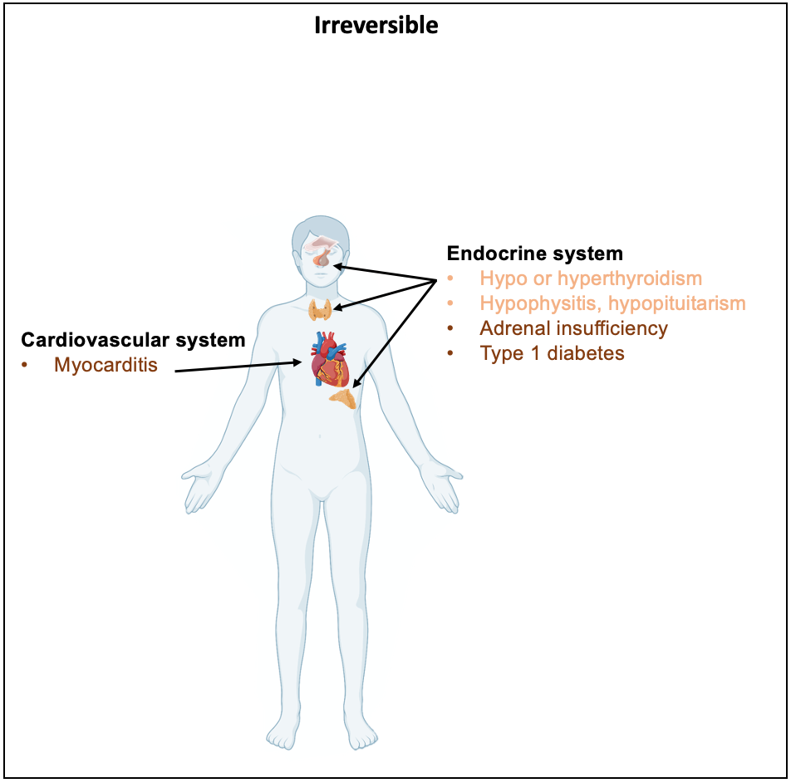
All Side Effects
Most common
Irreversible
Most Deadly
Immune system basics
How tumors ‘hide’
Immune checkpoints
Immune checkpoint inhibitors (ICIs)
When do we use ICIs?
Side effects of ICIs
CASES
Reference: 3-5; Created with BioRender.com
Notes:
Severe irAEs are as high as 16% in anti-PD-1 and up to 27% in anti-CTLA-4 antibody treatment. Moreover, in combination, irAEs rise to as much as 55% of the patients
Most commonly develop 8–12 weeks of commencing treatment, though can occur any time

Slide 11
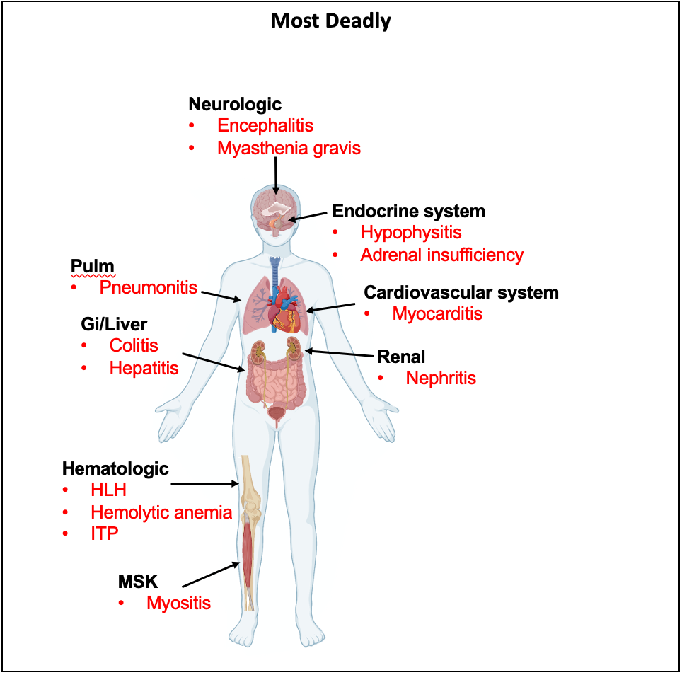
All Side Effects
Most common
Irreversible
Most Deadly
Immune system basics
How tumors ‘hide’
Immune checkpoints
Immune checkpoint inhibitors (ICIs)
When do we use ICIs?
Side effects of ICIs
CASES
Reference: 3-5; Created with BioRender.com
Notes:
Severe irAEs are as high as 16% in anti-PD-1 and up to 27% in anti-CTLA-4 antibody treatment. Moreover, in combination, irAEs rise to as much as 55% of the patients
Most commonly develop 8–12 weeks of commencing treatment, though can occur any time

Slide 12

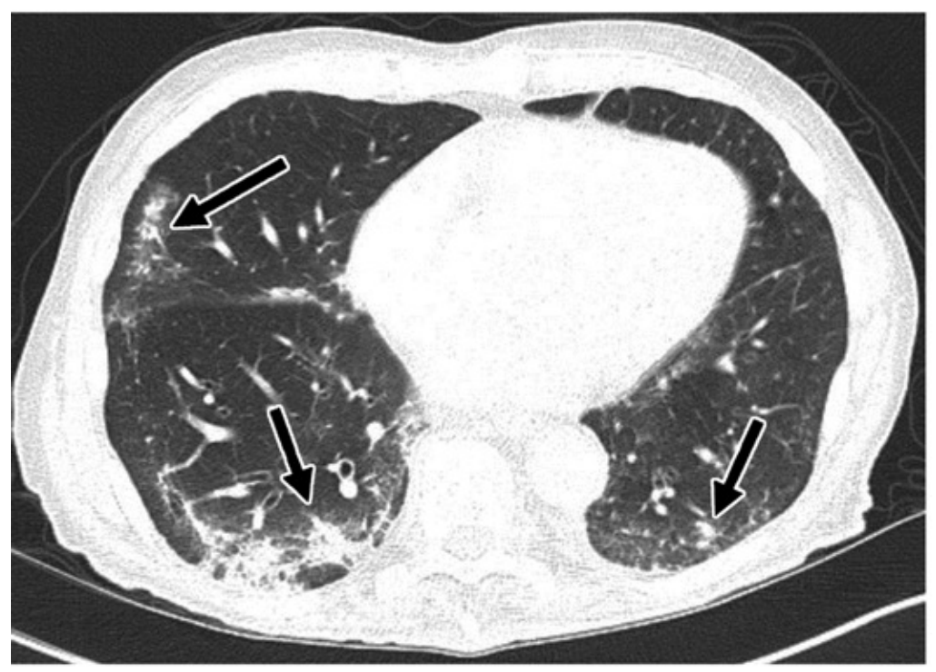
How do I treat immunotherapy toxicities?
Case 1
Case 2
Case 1: A 46 yo woman w/hx of metastatic melanoma being treated with nivolumab (anti-PD-1) and ipilimumab (anti-CTLA-4) presents to your primary care office with new onset diarrhea. Having 5-6 BMs per day, not interfering with her ADLs/IADLs
Case 2: A 68 yo gentleman with stage IV NSCLC on single agent pembrolizumab (anti-PD-1). On his 5th cycle he develops a worsening cough and dyspnea on exertion and comes into your office to be examined found to have SpO2 of 88% on RA with coarse b/l crackles.
What work up should you do?
What initial work up should you do?
Check stool PCR (r/o C diff and other infectious causes)
Lactoferrin/calprotectin
Nasal swab to eval for viral infections
Sputum culture
CT-chest with contrast
Consider pulm consult
NCCN-Immunotherapy Toxicity Treatment Guidelines
CT-scan looks like this…
What grade colitis does she have?
Grade 2
multifocal peripheral and subpleural mid- and lower-lung airspace consolidations (arrows)⁶
Basic framework to treat
ICI toxicity
Infectious w/up comes back negative.
What treatment should you offer?
Rule out other causes
Stop checkpoint inhibitor
Grade severity
Prednisone 1-2 mg/kg/day
If not improving in a few days consider additional agents
Hold nivolumab and ipilimumab
Prednisone 1-2 mg/kg/day
If no response in 2-3 days, continue steroids and consider adding infliximab or vedolizumab within 2 weeks
What treatment should you offer?
Hold pembrolizumab
Prednisone 1-2 mg/kg/day
Consider abx if infection not ruled out
If no response in 48 hrs, consider infliximab, IVIG or mycophenylate

Slide 13
2022–25 Update — New ICI Classes & irAE Guidance
New checkpoint target (3rd class): LAG-3.
Relatlimab+nivolumab (Opdualag) — first LAG-3-blocking combo; FDA approved Mar 2022 for unresectable/metastatic melanoma (RELATIVITY-047: median PFS 10.1 vs 4.6 mo).
More agents since the deck (Nov 2021):
Tremelimumab (anti-CTLA-4) + durvalumab — FDA approved 2022 (unresectable HCC, metastatic NSCLC). Dostarlimab (anti-PD-1) — dMMR endometrial/solid tumors.
irAE management framework unchanged (ASCO/NCCN, current):
G1 — continue ICI + monitor (exceptions: neuro/some heme). G2 — hold ICI, prednisone ~1 mg/kg, resume when ≤G1.
G3 — hold + high-dose steroid (prednisone/methylpred 1–2 mg/kg), taper ≥4–6 wk; add steroid-refractory agent (e.g. infliximab) if no response in 48–72 h.
G4 — permanently discontinue ICI (exception: endocrinopathies controlled on hormone replacement).
Irreversible/most-deadly irAEs to flag: myocarditis (~40–50% fatal), type 1 DM, primary adrenal insufficiency; check TSH/FT4 at baseline & q4–6 wk.

Slide 14
Take-Home Points
Tumors evade T cells by engaging immune checkpoints (PD-L1→PD-1, ligands→CTLA-4) that put the brakes on the immune response.
ICIs (anti-PD-1/PD-L1, anti-CTLA-4, and now anti-LAG-3) release those brakes; best in high-mutation-burden cancers (melanoma, lung, bladder).
irAEs are autoimmune, can hit any organ, and may appear during or months after therapy — keep ICIs on the differential.
Management framework: rule out other causes → stop ICI → grade severity → prednisone 1–2 mg/kg → add 2nd agent if no improvement in a few days.
Use the NCCN/ASCO irAE guidelines as your go-to resource at the bedside.

Slide 15
Attribution & Optimization Note
Adapted from TeachIM.org — “Immune Checkpoint Inhibitors” (Natalie Longino MD, Christopher Geiger MD, Erin Schenk MD; exec. ed. Brandon Fainstad MD). Published Nov 2021.
Source: teachim.org/teaching_material/immune-checkpoint-inhibitors-2/ · License: CC BY-NC 4.0 (attribution, non-commercial only).
Correction made (this copy): slide 6 — “Hodkin’s” → “Hodgkin’s” (FDA-approved-cancers list). All original animations/BioRender graphics preserved; no other slide content altered.
Added context (source-cited, 2022–25): LAG-3 inhibitor class (relatlimab/Opdualag, FDA Mar 2022); tremelimumab+durvalumab; dostarlimab; ASCO/NCCN irAE grading framework.
Companion file: LearnerHandout.pdf (cases). Educational use only; not medical advice — oncology therapy evolves, have content clinician-reviewed before teaching.

